Slide 1

DriverPass System Analysis
Christina Frediani
Notes:
[No speaker notes required for this slide.]

Slide 2

System Requirements
Functional Requirements
Customers can schedule driving lessons online
Customers can take online practice tests
Staff can manage reservations and assign drivers
The system processes secure online payments
Nonfunctional Requirements
System is accessible online 24/7
Customer data and payments are securely protected
Role-based access for employees
System maintains activity tracking and reporting
Notes:
The DriverPass system includes several important functional requirements that directly support the company’s goals. First, customers must be able to schedule driving lessons online, which allows them to book sessions conveniently without needing to call the office. Second, customers can take online practice tests, helping them prepare for the DMV exam. The system also allows staff to manage reservations and assign drivers and vehicles efficiently. In addition, secure online payment processing ensures that customers can safely purchase lesson packages.
In addition to these functional features, the system must meet several nonfunctional requirements. The system will be accessible online at all times so customers can schedule lessons whenever it is convenient. Security is critical, so customer data and payment information will be protected through encryption and secure authentication methods. Role-based access ensures that employees only have access to the features necessary for their job responsibilities. Finally, activity tracking and reporting provide accountability and allow the owner to monitor system usage and reservations.
These requirements ensure that the system supports DriverPass’s operational needs while maintaining security, reliability, and usability.

Slide 3
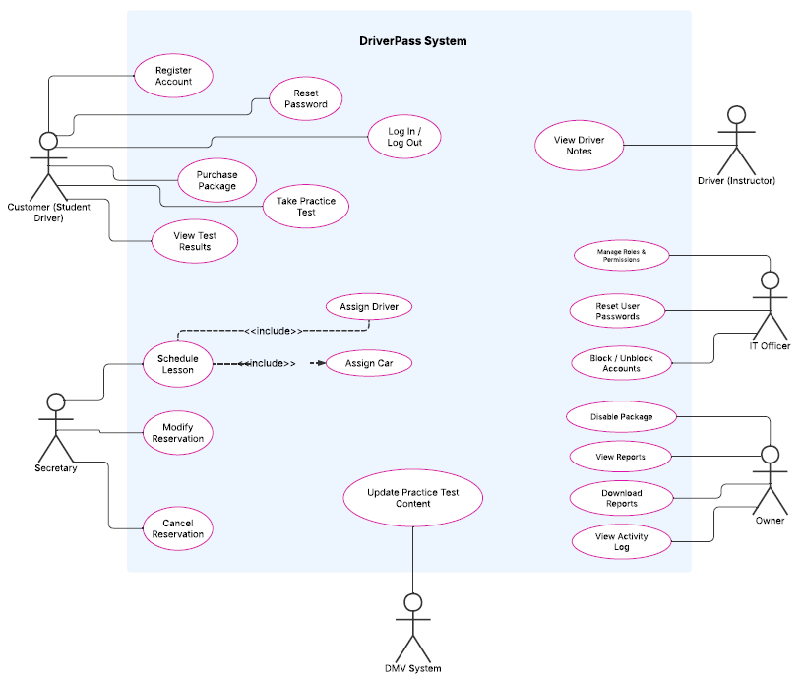
Use Case Diagram
Notes:
This diagram illustrates how different users interact with the DriverPass system and what actions they can perform.
Customers are able to create accounts, log in and out, reset their passwords, purchase lesson packages, schedule lessons, and take practice tests. They can also view their test results after completing practice exams.
The secretary can assist customers by scheduling, modifying, or canceling reservations. When a lesson is scheduled, the system automatically assigns both a driver and a vehicle to that reservation.
Drivers have access to view and manage lesson-related information, including reviewing notes connected to their sessions.
The IT officer manages system access and security by resetting user passwords, blocking or unblocking accounts, and managing roles and permissions.
The owner can disable packages, generate reports, download reports, and view activity logs to monitor system usage and business performance.
The system also connects to the DMV system to ensure that practice test content stays current and reflects updated rules or exam requirements.
Overall, this design ensures that each person involved with DriverPass has access only to the features necessary for their responsibilities, while still supporting the company’s goal of offering secure online scheduling, test preparation, and administrative oversight.

Slide 4
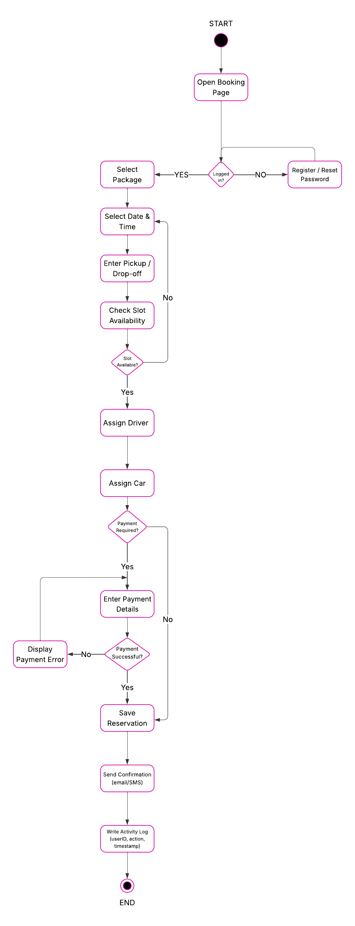
Activity Diagram
Notes:
This diagram breaks down the process a customer follows to schedule a driving lesson.
The process begins when the customer logs into the system. If they do not have an account or forget their password, they can register or reset their password before continuing. Once logged in, the customer selects a lesson package and chooses a preferred date and time, along with their pickup and drop-off location.
The system then checks whether the selected time slot is available. If the time is not available, the customer can choose another time. If the slot is available, the system automatically assigns both a driver and a vehicle for that lesson.
If payment is required, the customer enters their payment information. If the payment is unsuccessful, the system notifies the customer and allows them to try again. Once payment is successfully processed, the reservation is saved.
Finally, the system sends a confirmation message to the customer and records the transaction in the activity log. This ensures that all reservations are tracked and that DriverPass has a record of each booking.
This process supports DriverPass’s goal of providing an easy, secure, and efficient online scheduling system while maintaining accountability and proper tracking.

Slide 5
Security
Security
Secure login and password protection
Role-based access for staff
Encrypted payment processing
Account lockout after failed login attempts
Activity tracking for reservations and changes
Secure online data transmission
Notes:
Security was a major consideration in the design of the DriverPass system. First, all users must log in using secure credentials, and passwords are protected to prevent unauthorized access. If a user enters incorrect login information multiple times, the system temporarily locks the account to prevent misuse.
The system uses role-based access, meaning each employee only has access to the features necessary for their job. For example, the IT officer can manage accounts, while the secretary can manage reservations. This prevents unauthorized changes.
All online payments are processed through a secure payment service to ensure that customer financial information is protected. The system does not store sensitive payment details directly.
Additionally, all data transmitted between users and the system is encrypted, protecting personal information from being intercepted. The system also records all important actions, such as reservation changes or account updates, in an activity log to provide accountability and transparency.
These security measures ensure that customer information remains protected while allowing DriverPass to operate efficiently and securely.

Slide 6
System Limitations
System Limitations
Requires internet access to schedule or manage lessons
Practice test content depends on DMV updates
Limited to current package structure
Driver and vehicle availability must be updated accurately
Payment processing depends on third-party service
Notes:
While the DriverPass system is designed to meet your operational needs, there are a few limitations to consider.
First, because the system is web-based, users must have internet access to schedule lessons, take practice tests, or manage accounts. If internet service is unavailable, system access will be temporarily limited.
Second, practice test content depends on updates provided by the DMV. If the DMV changes its requirements but does not immediately update its system, there may be a short delay before new content appears.
Third, the system currently supports a defined set of lesson packages. While packages can be managed by the owner, creating entirely new package structures may require system updates.
Additionally, the accuracy of scheduling depends on properly maintained driver and vehicle availability. Administrative staff must ensure schedules are updated consistently.
Finally, payment processing relies on a secure third-party payment provider. If that service experiences downtime, payments may be temporarily unavailable.
These limitations are common in online systems and can be managed with proper administrative oversight.

